Slide 1

Alvina Lee Hui Shan, Lee Meng Yong, Ang Hai Soon

Slide 2
Scope
Motivation
Data Sources and Characteristics
Methodology
Sharing of Findings
Conclusion
Demonstration of prototype

Slide 3
Motivation
Buying of HDB flat is an important decision for young couples
Filled with uncertainties
Investment in Fixed Asset – large capital outlay and long term commitment
What type of loans ?
Resale value
What are the factors affecting the resale value ?
Should I factor in my children’s education ?
Reduce uncertainty for first time buyers of HDB flat by providing visibility on the factors that influence the HDB resale market.

Slide 4




Data Sources and Characteristics (n = 53,402)
Data | Sources | Characteristics
Nearest primary school |  | 182 Primary Schools
Town |  | 26 towns e.g. Ang Mo Kio, Clementi.
Flat Type |  | 4 levels – 3 room, 4 room, 5 room, Executive
Flat Model |  | 19 levels e.g. DBSS, Improved, Mansionette.
Floor area (sqm) |  | 52 to 259 sqm.
Remaining Lease |  | 47 to 97 years.
Storey |  | 1 to 51 storey.

Slide 5

Methodology
Data
Nearest primary school
Town
Flat Type
Flat Model
Floor area (sqm)
Remaining Lease
Storey
Data Explorer
Estimate Price
Findings
Build Linear Regression Model
Data
Town
Flat Type
Flat Model
Floor area (sqm)
Remaining Lease
Storey

Slide 6
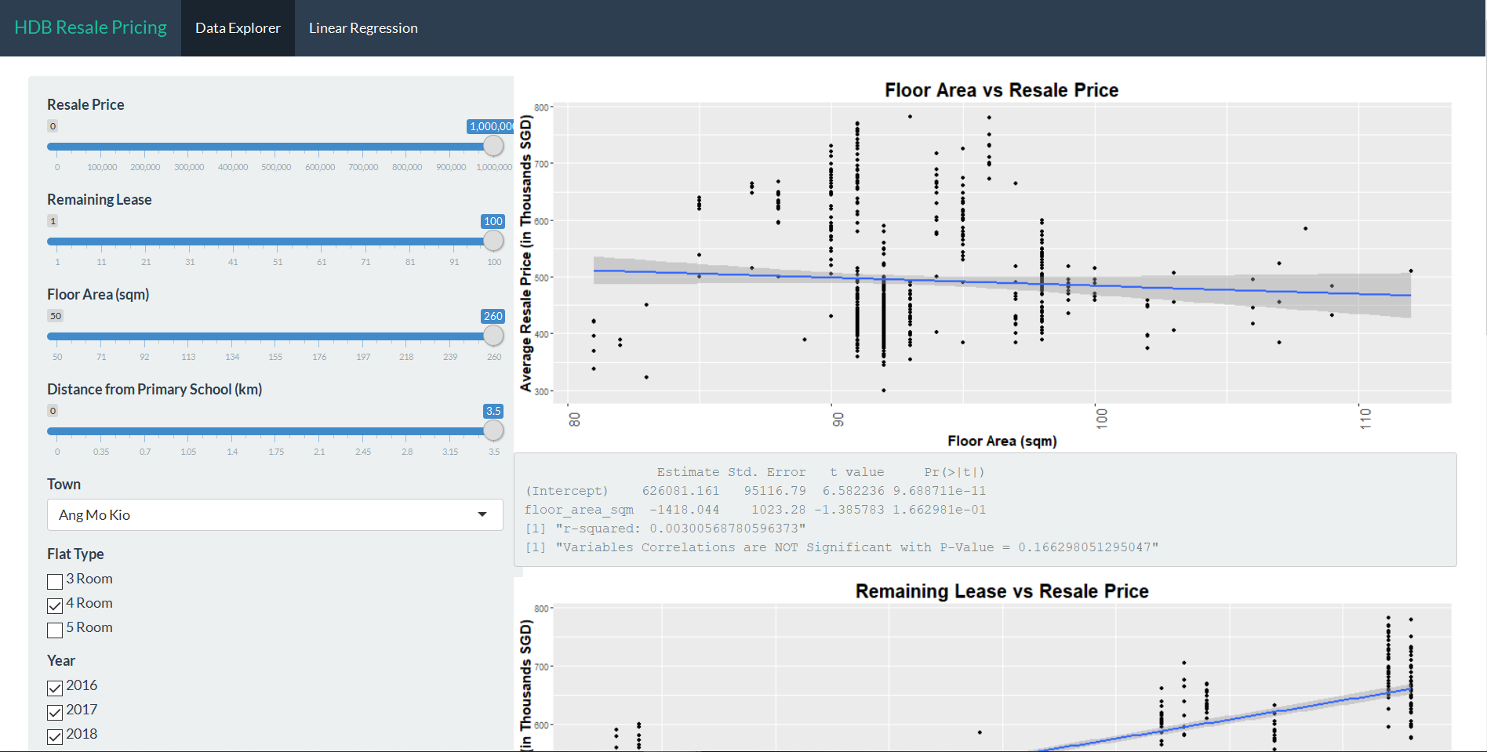
Tab 1 : Data Exploration / Hypothesis Testing
Price vs Distance to Primary School
Price vs Remaining Lease
Price vs Floor Area
Tab 2: Prediction
Prediction Model
Predicted vs Actual Resale Price
Residual Distribution

Slide 7
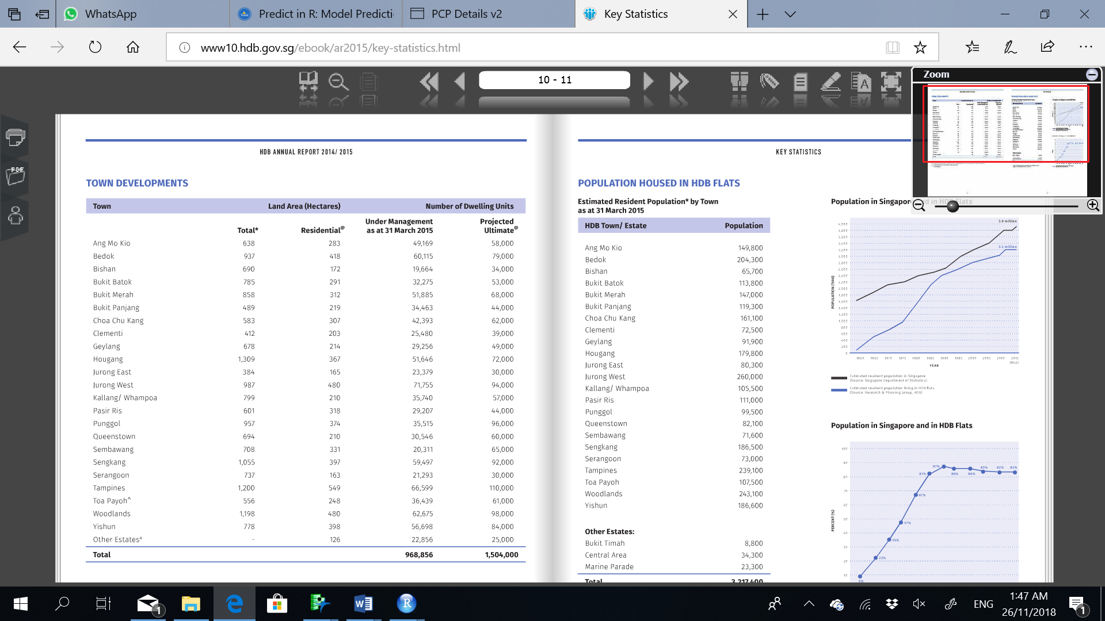
Finding 1 - Resale price of HDBs will be affected by the distance between the HDBs and the primary schools
Besides Bukit Batok, also statistically significant in the following :
Bishan ~ with popular primary schools
Bukit Merah
Marine Parade ~ with popular primary schools
Pasir Ris
Sembawang
Tampines
Toa Payoh
Woodlands
Yishun
Statistically significant relationship with Resale Price for
1. towns with popular primary schools e.g. Tao Nan, Catholic High
2. towns with >=5 primary schools
3. higher population density

Slide 8
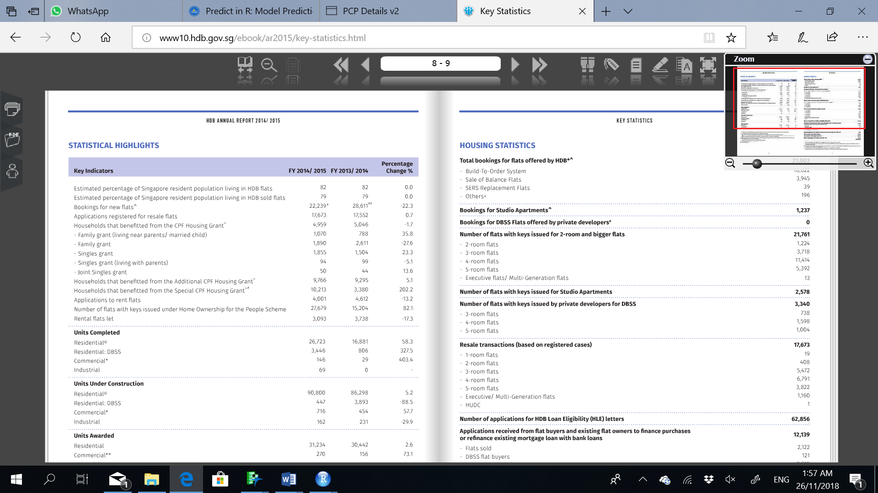
Finding 2 – Association between Flat Model, Floor area and Location of HDB
This is probably because nuclear family model is the general trend in Singapore, hence citizens tend to go for the smaller flat model. This is further confirmed by HDB’s 2015 statistics.

Slide 9
Conclusion and Demonstration of Prototype
Well known that location affects the resale price of HDB flats.
Data analysis provides clarity on the finer details of location e.g. flat models, distance to certain primary schools, floor areas, which are backed by statistics.

Slide 10
